Slide 1

Orion-X
Orion-X
Orion-X

Slide 2

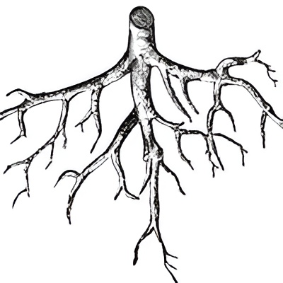





Seismic detection across the solar system
Bhavesh Dutta
Sasanka Shekhar Kundu
Suparna Sonar
Purvesh Mali
Aryan Khekre
Johnson Nadar

Slide 3
Seismic detection across the solar system
Sasanka Shekhar Kundu
Suparna Sonar
Bhavesh Dutta
Aryan Khekre
Johnson Nadar
Purvesh Mali
Seismic Detection Across the Solar System is a project focused on studying seismic activity on planetary bodies, specifically the Moon and Mars. The primary goal was to develop an algorithm capable of filtering seismic data to isolate and detect specific quake events from noisy signals, enabling detailed analysis of planetary seismic activity.
During the hackathon, we built a prototype and developed algorithms that worked with real seismic datasets from NASA's catalog. We used tools like JupyterLab, Python, Matplotlib, Pandas, NumPy, scikit-learn, and ObsPy to process and analyze the data. The main challenge was efficiently filtering out noise to identify relevant seismic sections, a crucial step for advancing the study of extraterrestrial seismic phenomena.

Slide 4
Seismic detection across the solar system
Seismic Detection Across the Solar System is a project focused on studying seismic activity on planetary bodies, specifically the Moon and Mars. The primary goal was to develop an algorithm capable of filtering seismic data to isolate and detect specific quake events from noisy signals, enabling detailed analysis of planetary seismic activity.
During the hackathon, we built a prototype and developed algorithms that worked with real seismic datasets from NASA's catalog. We used tools like JupyterLab, Python, Matplotlib, Pandas, NumPy, scikit-learn, and ObsPy to process and analyze the data. The main challenge was efficiently filtering out noise to identify relevant seismic sections, a crucial step for advancing the study of extraterrestrial seismic phenomena.
Project Overview: Leveraging Advanced Algorithms for Seismic Event Detection
In this project, we employ two key algorithms to enhance the detection and analysis of seismic events on the Moon and Mars:
1. STA/LTA (Short-Term Average/Long-Term Average) Algorithm - Objective: To detect seismic events by analyzing the ratio of short-term and long-term signal averages. - Functionality: Efficiently filters seismic data to isolate potential quake signals from background noise, ensuring more accurate event identification.

Slide 5
Random Forest
: -
Objective:-A non-linear ensemble model that improves detection accuracy in complex, noisy data environments.
Application:-Handles subtle and overlapping seismic signals, enhancing detection capability in challenging data scenarios.
Tools and Technologies
- JupyterLab,Python, Matplotlib, Pandas, NumPy, Scikit-learn, ObsPy
STA / LTA Algorithm Overview
Project Overview: Leveraging Advanced Algorithms for Seismic Event Detection
In this project, we employ two key algorithms to enhance the detection and analysis of seismic events on the Moon and Mars:
The **STA/LTA (Short-Term Average/Long-Term Average)** algorithm is widely used in **seismology** to detect events such as earthquakes by identifying changes in a time-series signal. It compares recent signal activity (STA) with long-term baseline behavior (LTA), effectively distinguishing between normal background noise and significant events.

Slide 6
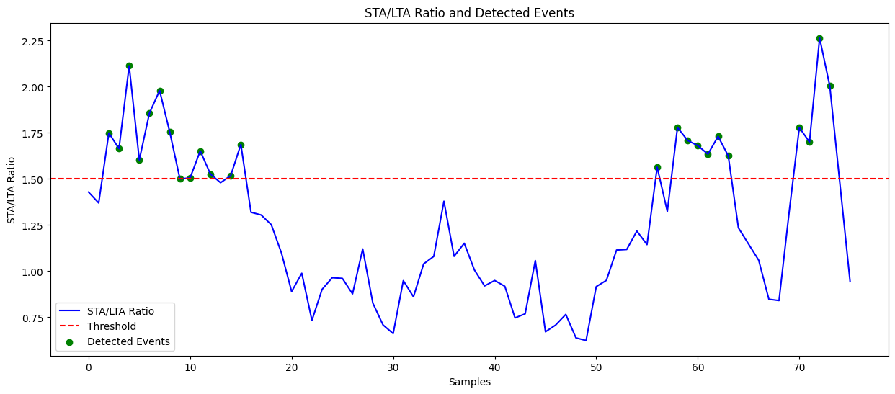
Key Considerations
STA/LTA Ratio (Blue Line):
~ The blue line represents the STA/LTA ratio values over time (or samples). Peaks in the graph indicate moments when the short-term signal is significantly stronger than the long-term average, which might suggest the occurrence of an event.
Threshold (Red Dashed Line):
~ The horizontal red dashed line represents a threshold (set at a ratio of 1.50 in this case). When the STA/LTA ratio crosses this threshold, it indicates that an event has potentially occurred.

Slide 7
Interpretation:
The graph shows fluctuating STA/LTA ratios, with a number of peaks that exceed the threshold, indicating detected seismic or signal events
.
The series of green circles in the early part of the graph suggests that multiple events were detected in rapid succession, while later parts show fewer detected events, followed by a rise towards the end.
Conclusion
Through this project, we not only succeeded in detecting seismic events but also provided insights into the unique characteristics of seismic activities on different celestial bodies. For instance, Mars quakes were detected with significantly different signal patterns compared to Earth, highlighting the need for customized algorithms for each planetary body. The hackathon allowed us to push the boundaries of current seismic event detection, applying innovative solutions to interpret extraterrestrial data. Our work has the potential to enhance the understanding of planetary geology and could serve as a foundation for future planetary missions, improving the ability to monitor and analyze seismic events throughout the solar system. In the long run, this project could contribute to identifying tectonic movements, volcanic activity, and even potential underground oceans on moons, helping humanity prepare for future exploration and colonization of other planets and moons
Our hackathon project aimed to explore and detect seismic events across the solar system by leveraging cutting-edge data analysis techniques. Using the STA/LTA (Short-Term Average/Long-Term Average) method, we developed a real-time detection system capable of identifying seismic activities on various planetary bodies, such as Mars, the Moon, and even moons of gas giants like Europa and Enceladus. The project harnessed publicly available seismic data from interplanetary missions, such as NASA’s InSight on Mars, and demonstrated the feasibility of adapting terrestrial seismic monitoring techniques for extraterrestrial environments.
.
THANK
YOU

Slide 8
Conclusion
THANK
YOU
Through this project, we not only succeeded in detecting seismic events but also provided insights into the unique characteristics of seismic activities on different celestial bodies. For instance, Mars quakes were detected with significantly different signal patterns compared to Earth, highlighting the need for customized algorithms for each planetary body. The hackathon allowed us to push the boundaries of current seismic event detection, applying innovative solutions to interpret extraterrestrial data. Our work has the potential to enhance the understanding of planetary geology and could serve as a foundation for future planetary missions, improving the ability to monitor and analyze seismic events throughout the solar system. In the long run, this project could contribute to identifying tectonic movements, volcanic activity, and even potential underground oceans on moons, helping humanity prepare for future exploration and colonization of other planets and moons

